Slide 1
DOBBS ELEMENTARY
BUDGET FEEDBACK MEETING
To be presented to GO Team BEFORE the school staffing conference

Slide 2




NORMS
This is a meeting of the GO Team. Only members of the team may participate in the discussion. Any members of the public present are here to quietly observe.
We will follow the agenda as noticed to the public and stay on task.
We invite and welcome contributions of every member and listen to each other.
We will respect all ideas and assume good intentions.

Slide 3



GO TEAM BUDGET DEVELOPMENT PROCESS
YOUR SCHOOL STRATEGIC PLAN…
is your roadmap and your role.
It is your direction, your priorities, your vision, your present, your future.
Step 1: Data Review
Step 2: Strategic Plan Review
Step 3: Budget Parameters
(Strategic Priorities)
Step 4: Budget Choices
Notes:
Today I will provide an overview of the budget allocations for FY23. We will begin the work of funding the strategic priorities we agreed upon during our strategic review meeting. (IF YOU HAVE NOT DECIDED ON YOUR PRIORITIES, YOU WILL SAY – WE WILL DECIDE ON OUR PRIORITIES AND THEN DISCUSS ALLOCATING FUNDS TO ADDRESS THOSE PRIORITIES).

Slide 4
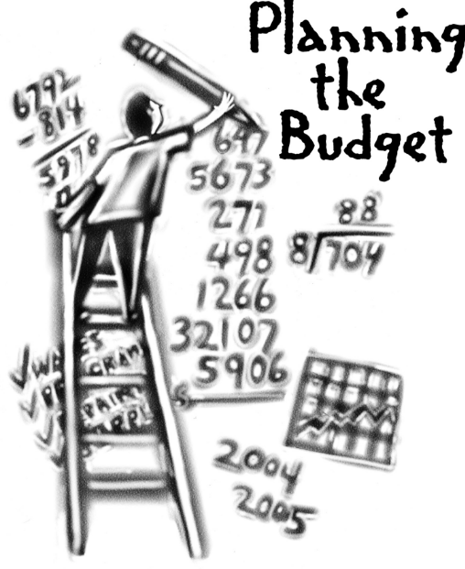
Overview of FY ‘24 GO Team Budget Process
Step 7 GO Team Final Budget Approval Meeting
Budgets Approved by March 17
Step 6 Principals: HR Staffing Conferences Begin
Late February – Early March
Step 5
GO Team Feedback Session: Draft Budget Presented & Discussed February – multiple meetings, if necessary
Step 4 Principals: Associate Supt. Discussions and Review
February (supports needed, specific challenges, coaching)
Step 3 GO Team Initial Budget Session: Allocation
January 24 – early February
Step 2 Principals: Workshop FY 24 Budget
January 24
Step 1 Review and Update Strategic Plan and Rank Strategic Priorities
By end of Fall Semester
GO Teams are encouraged to have ongoing conversations

Slide 5
Budget Feedback Meetings
What
The GO Team feedback session(s) should be scheduled for the principal to provide an overview of the school’s draft budget for the GO Team members and the general public.
Why
This meeting provides an opportunity for GO Teams to discuss how the school’s budget has been allocated to support the programmatic needs and key strategic priorities.
When
Meetings must be held in February before staffing conferences. May be combined with the allocation meeting (as needed), if the GO Team has completed strategic plan updates and ranked strategic priorities.
Notes:
Looking for general consensus prior to Staffing Conferences

Slide 6

FY24 Budget Parameters
FY24 School Priorities | Rationale
Increase STUDENT proficiency in Literacy and Mathematics | Strategic Plan Goals Increase the # of Teachers for Targeted, small group Instruction
Increase STAFF capacity in literacy instruction. | Increase # of support staff supporting teachers Increase Principal Support to free up time for Instruction Focus
Increase Staff capacity in data analysis and usage for instructional decision making. | There is a need for enhanced teacher support to be able to assist teachers with data analysis that will impact student learning
Notes:
Review the priorities that the GO Team has developed and the rationale for these priorities. Feel free to copy this slide if you have more than 3 priorities to account for.

Slide 7
FY24 Budget Parameters
FY24 School Priorities | Rationale
Utilize data to meet the individual needs of students. | Ensure that students are receiving maximized opportunities for achievement and remediation daily.
Monitor the communication to parents of students chronically absent. | Absent students affect the CCRPI score and adversely impact achievement.
FY24 School Prioriies | Rationale
Maintain lower class sizes in the primary ears by funding parapros in 1st and second grade | 47% mobility rate requires a great deal of teacher attention to students who enter our school throughout the year – many of which are below level.
Maximize wrap around services ie: Nurse, SSW, Counseling | This continues to be a need for our students, but we need to look closely at maximizing our budget to make this work.
Increase Reading/Lexiles and writing of 3rd – 5th grade students. How can we restructure our program to achieve this? | Data indicates that students who have been with us for more than one year have greater performance levels than students who are transient. With 47% of our students
Example
Notes:
Review the priorities that the GO Team has developed and the rationale for these priorities. Feel free to copy this slide if you have more than 3 priorities to account for.

Slide 8
Descriptions of Strategic Plan
Breakout Categories
Priorities: FY24 funding priorities from the school’s strategic plan, ranked by the order of importance.
APS Five Focus Area: What part of the APS Five is the priority aligned to?
Strategies: Lays out specific objectives for schools improvement.
Request: “The Ask” What needs to be funded in order to support the strategy?
Amount: What is the cost associated with the Request?

Slide 9
FY24 Strategic Plan Break-out
Priorities | APS FIVE Focus Area | Strategies | Requests | Amount
#1 - Increase proficiency in literacy & mathematics | Curriculum & Instruction | Implement literacy strategies from Rollins Center Utilize small group instruction to provide individualized instruction | Purchase TWO Turnaround Teachers for Reading Lab & Math Lab during Specials. Increase EIP Teachers from 1 to 4. | $450,000
#2 Increase daily average attendance rate |  | Utilize Care Team and Attendance Committee to coordinate supports for students with absences Implement attendance incentive program | Student incentives | 10,000
#3 – Increase staff capacity in literacy instruction | Curriculum & Instruction | Instructional staff engagement in the Rollins Center training and other trainings | Professional development, instructional resources for teachers, web-based licenses and subscriptions for teachers & students | $306,000
Notes:
For the next few slides, I will show you how I have allocated the budget to support our strategic priorities.
Based on our strategic priorities and funds we received, here is a break-out of the priorities, which focus area it addresses, the strategies that will be implemented, the purchase request, which funding source was used and the amount.

Slide 10
FY24 Strategic Plan Break-out
Priorities | APS FIVE Focus Area | Strategies | Requests | Amount
Increase level of rigor and relevance (example- please remove) | Fostering Academic Excellence for All (example- please remove) | Implementation of guided reading training for all staff (example- please remove) | Purchase an additional Teacher (example- please remove) | $84, 134 (example- please remove)
#4 – Staff capacity in data analysis and usage for instructional decision making. | Curriculum & Instruction | Staff engagement in bi-weekly data meetings. Leadership & Instructional support staff to support teachers in lesson planning and implementation. | Purchase an additional coach and business manager to maximize admin’s time with the teachers to build capacity. | $356, 271
#5 – Increase STEM integration. | Curriculum & Instruction | Engage in Monthly STEM professional learning and planning. | Purchase a STEM Lab Teacher | $ 90,000
Notes:
For the next few slides, I will show you how I have allocated the budget to support our strategic priorities.
Based on our strategic priorities and funds we received, here is a break-out of the priorities, which focus area it addresses, the strategies that will be implemented, the purchase request, which funding source was used and the amount.

Slide 11
Plan for FY24 CARES Allocation
Priorities | APS FIVE Focus Area | Strategies | Requests | Amount
Increase proficiency in literacy and math. | Curriculum & Instruction | Utilize small group instruction for individualized learning | Purchase I-Ready for after school tutorial Provide school transportation for student Provide stipends for after school teachers | 215,000
Notes:
For the next few slides, I will show you how I have allocated the budget to support our strategic priorities.
Based on our strategic priorities and funds we received, here is a break-out of the priorities, which focus area it addresses, the strategies that will be implemented, the purchase request, which funding source was used and the amount.

Slide 12
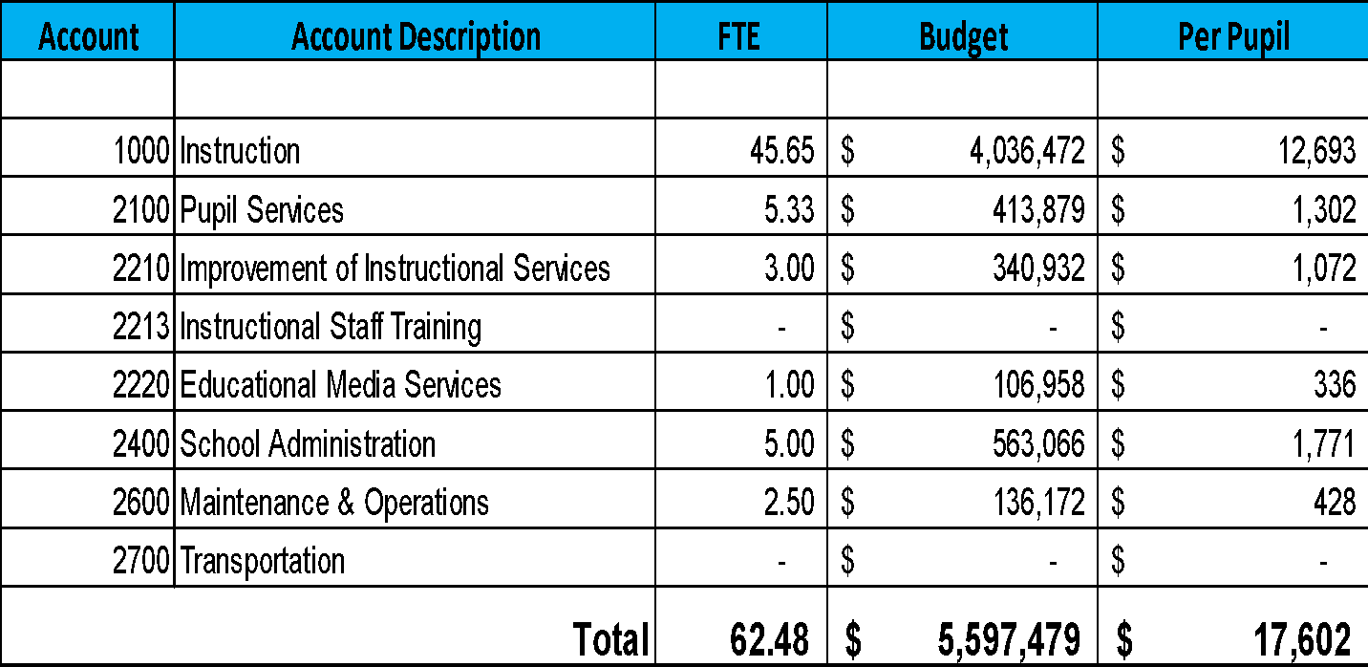
Budget by Function (Required)
*Based on Current Allocation of School Budget
Notes:
I am passing out the definitions for these funding categories. You will see what makes up each category. Although the school’s total budget amount will not change, allocation per function may change depending on our conversations and school needs.

Slide 13
Budget by Function (Required)
*Based on Current Allocation of School Budget
Example
Notes:
Explain the pie chart and allocations

Slide 14
QUESTIONS FOR THE GO TEAM TO CONSIDER AND DISCUSS
Are our school’s priorities (from your strategic plan) reflected in this budget?
  Are new positions and/or resources included in the budget to address our major priorities?
  Do we know (as a team) the plan to support implementation of these priorities beyond the budget (ex. What strategies will be implemented)?
  What tradeoffs are being made in order to support these priorities?
How are district and cluster priorities reflected in our budget?
  Cluster priorities- what staff, materials, etc. are dedicated to supporting our cluster’s priorities?
  Signature programs- what staff, materials, etc. are dedicated to supporting our signature program?
  Are there positions our school will share with another school, i.e. nurse, counselor?
Notes:
CHAIR - Our final task for today! Here are questions that we need to consider to ensure we have a good working draft budget. Let’s walk through them together.

Slide 15
Where We’re Going?
Our next meeting is the Budget Approval Meeting
What:
During this meeting we will review the budget, which should be updated based on feedback from the staffing conference, Associate Superintendents, and key leaders. After review, GO Teams will need to take action (i.e., vote) on the FY24 Budget.
Why:
Principals will present the final budget recommendations for GO Team approval.
When:
All approval meetings must be held after staffing conferences. Budgets must be approved by March 17th.

Slide 16
Thank you

